Slide 1

Digital Fundamentals
Tenth Edition
Floyd
Chapter 5
© 2008 Pearson Education

Slide 2

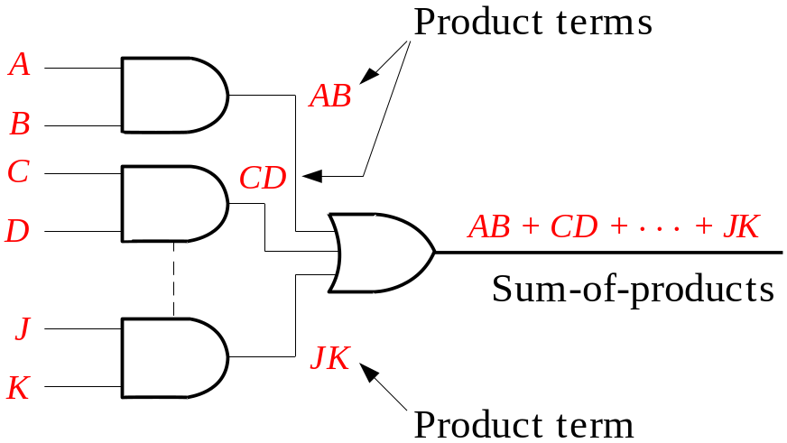
Summary
Combinational Logic Circuits
In Sum-of-Products (SOP) form, basic combinational circuits can be directly implemented with AND-OR combinations if the necessary complement terms are available.

Slide 3
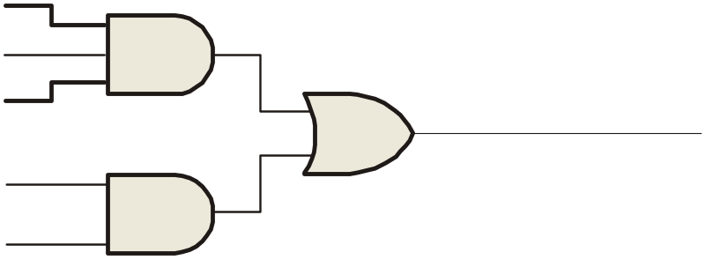
Summary
Combinational Logic Circuits
An example of an SOP implementation is shown. The SOP expression is an AND-OR combination of the input variables and the appropriate complements.
A
B
ABC
C
X = ABC
+ DE
SOP
D
E
DE

Slide 4
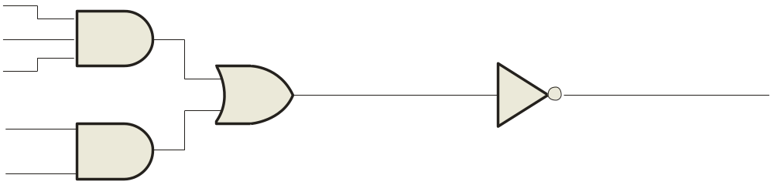
Summary
Combinational Logic Circuits
When the output of a SOP form is inverted, the circuit is called an AND-OR-Invert circuit. The AOI configuration lends itself to product-of-sums (POS) implementation.
An example of an AOI implementation is shown. The output expression can be changed to a POS expression by applying DeMorgan’s theorem twice.
A
B
ABC
C
X = ABC
+ DE
X = ABC
+ DE
AOI
D
X = (ABC)(DE)
DeMorgan
E
DE
X = (A + B + C)(D + E)
POS

Slide 5
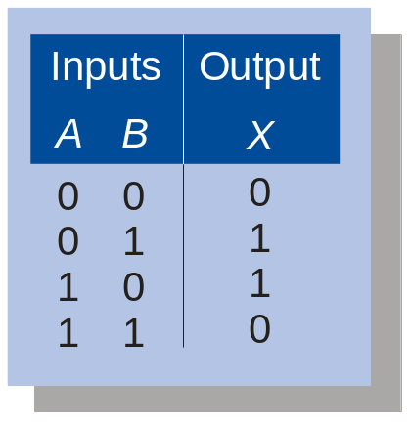
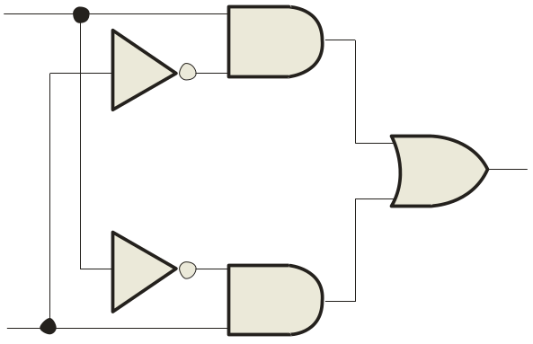
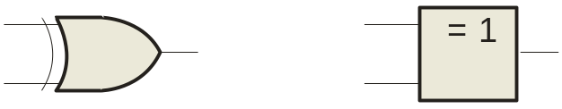
Summary
Exclusive-OR Logic
The truth table for an exclusive-OR gate is
Notice that the output is HIGH whenever A and B disagree.
The Boolean expression is
X = AB + AB
The circuit can be drawn as
A
Symbols:
X
Distinctive shape Rectangular outline
B

Slide 6
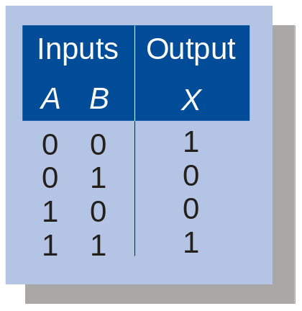
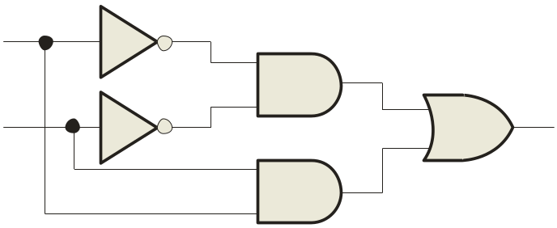
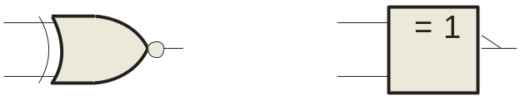
Summary
Exclusive-NOR Logic
The truth table for an exclusive-NOR gate is
Notice that the output is HIGH whenever A and B agree.
The Boolean expression is
X = AB + AB
The circuit can be drawn as
A
Symbols:
X
B
Distinctive shape Rectangular outline

Slide 7
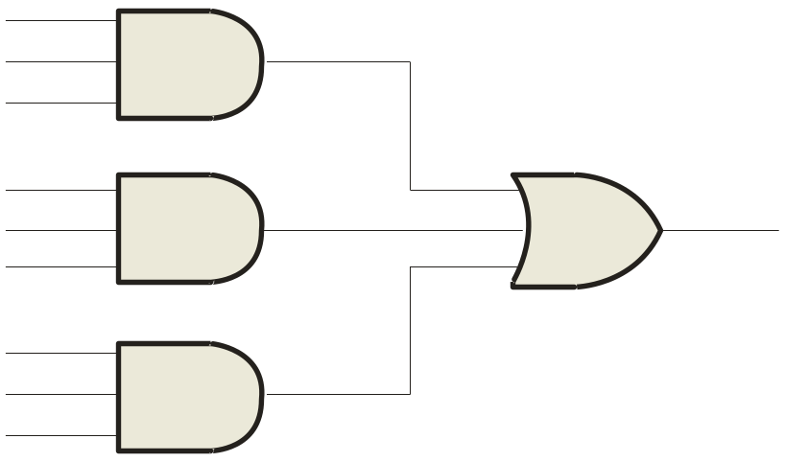

Summary
Implementing Combinational Logic
Implementing a SOP expression is done by first forming the AND terms; then the terms are ORed together.
Example
Show the circuit that will implement the Boolean expression X = ABC + ABD + BDE. (Assume that the variables and their complements are available.)
Solution
Start by forming the terms using three 3-input AND gates.
Then combine the three terms using a 3-input OR gate.
A
B
C
A
X = ABC + ABD + BDE
B
D
B
D
E

Slide 8
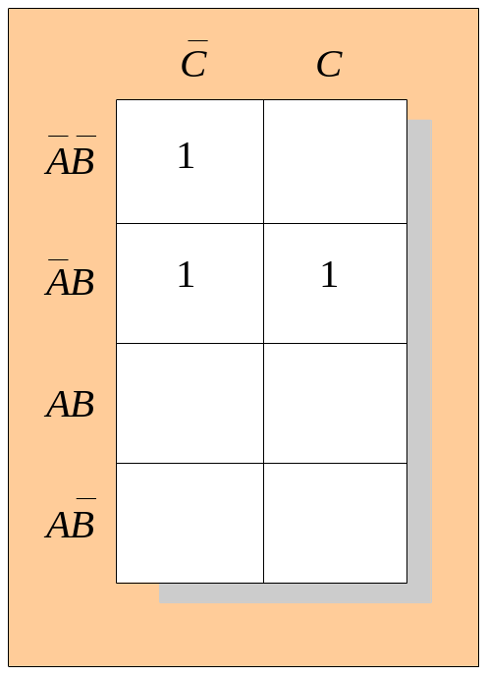
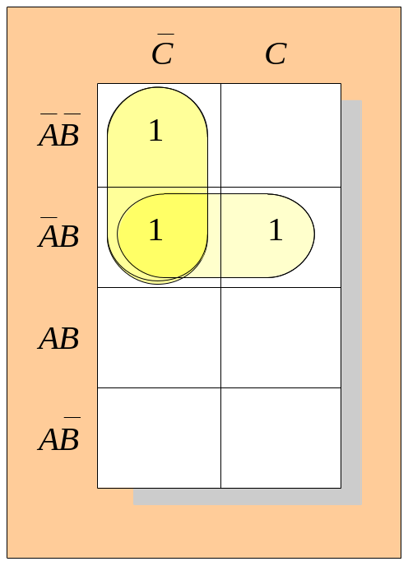
Summary
Karnaugh Map Implementation
For basic combinational logic circuits, the Karnaugh map can be read and the circuit drawn as a minimum SOP.
Example
A Karnaugh map is drawn from a truth table. Read the minimum SOP expression and draw the circuit.
Solution
1. Group the 1’s into two overlapping groups as indicated.
Read each group by eliminating any variable that changes across a boundary.
B changes across this boundary
The vertical group is read A C.
C changes across this boundary
The horizontal group is read AB.
The circuit is on the next slide:

Slide 9
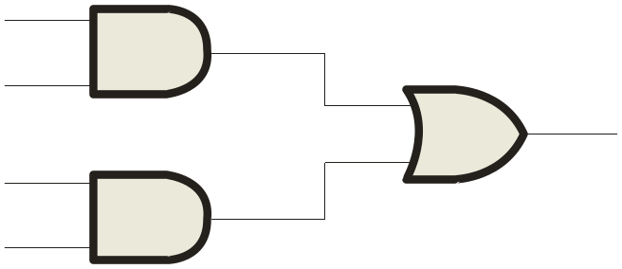
Summary
Solution
continued…
Circuit:
A
C
X =
A
C
+
A
B
A
B
The result is shown as a sum of products.
It is a simple matter to implement this form using only NAND gates as shown in the text and following example.

Slide 10

Summary
NAND Logic
Example
Convert the circuit in the previous example to one that uses only NAND gates.
Solution
Recall from Boolean algebra that double inversion cancels. By adding inverting bubbles to above circuit, it is easily converted to NAND gates:
A
C
X =
A
C
+
A
B
A
B

Slide 11
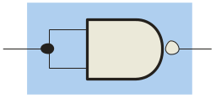
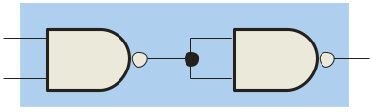
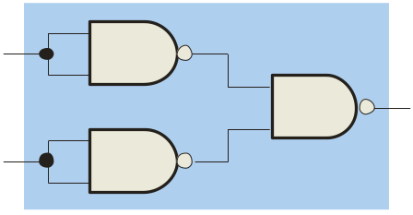
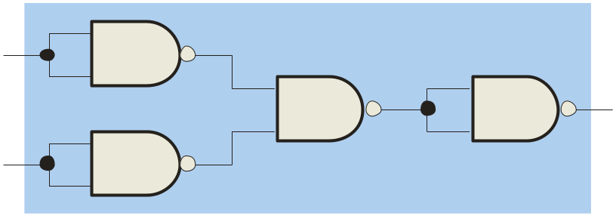
Summary
Universal Gates
NAND gates are sometimes called universal gates because they can be used to produce the other basic Boolean functions.
A
A
A
AB
B
Inverter
AND gate
A
A
A + B
A + B
B
B
OR gate
NOR gate

Slide 12
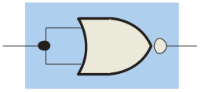
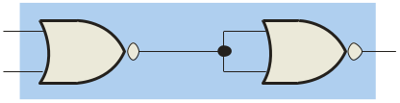
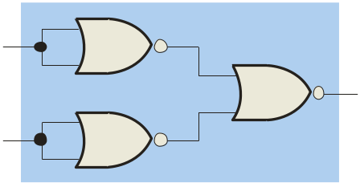
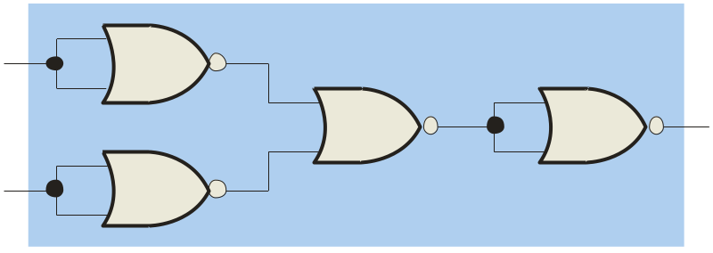
Summary
Universal Gates
NOR gates are also universal gates and can form all of the basic gates.
A
A
A
A + B
B
Inverter
OR gate
A
A
AB
AB
B
B
AND gate
NAND gate

Slide 13
Summary
NAND Logic
Recall from DeMorgan’s theorem that AB = A + B. By using equivalent symbols, it is simpler to read the logic of SOP forms. The earlier example shows the idea:
A
C
X =
A
C
+
A
B
A
B
The logic is easy to read if you (mentally) cancel the two connected bubbles on a line.

Slide 14
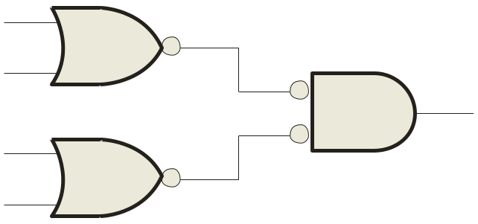
Summary
NOR Logic
Alternatively, DeMorgan’s theorem can be written as A + B = A B. By using equivalent symbols, it is simpler to read the logic of POS forms. For example,
A
B
X =
(A + B)(A + C)
A
C
Again, the logic is easy to read if you cancel the two connected bubbles on a line.

Slide 15

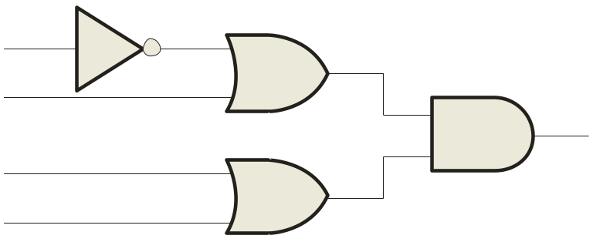
Summary
Pulsed Waveforms
For combinational circuits with pulsed inputs, the output can be predicted by developing intermediate outputs and combining the result. For example, the circuit shown can be analyzed at the outputs of the OR gates:
A
A
G₁
B
B
G₃
C
C
D
G₂
D
G₁
G₂
G₃

Slide 16
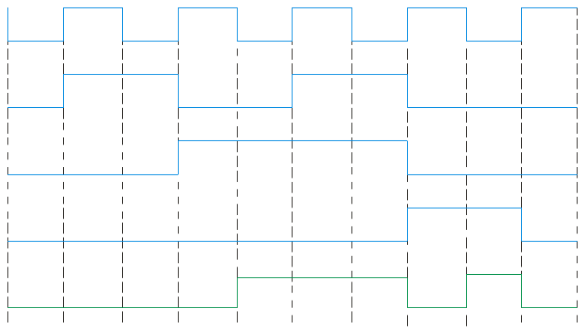
Summary
Pulsed Waveforms
Inputs
Output
Alternatively, you can develop the truth table for the circuit and enter 0’s and 1’s on the waveforms. Then read the output from the table.
A B C D
X
0 0 0 0
0
0 0 0 1
1
A
0 0 1 0
1
G₁
0 0 1 1
1
B
0 1 0 0
0
G₃
C
0 1 0 1
1
G₂
0 1 1 0
1
D
0 1 1 1
1
1 0 0 0
0
A
0 1 0 1 0 1 0 1 0 1
1 0 0 1
0
0 1 1 0 0 1 1 0 0 0
1 0 1 0
0
B
1 0 1 1
0
C
0 0 0 1 1 1 1 0 0 0
1 1 0 0
0
1 1 0 1
1
D
0 0 0 0 0 0 0 1 1 0
1 1 1 0
1
G₃
0 0 0 0 1 1 1 0 1 0
1 1 1 1
1

Slide 17
Selected Key Terms
Universal gate
Negative-OR
Negative-AND
Either a NAND or a NOR gate. The term universal refers to a property of a gate that permits any logic function to be implemented by that gate or by a combination of gates of that kind.
The dual operation of a NAND gate when the inputs are active-LOW.
The dual operation of a NOR gate when the inputs are active-LOW.

Slide 18

Quiz
1. Assume an AOI expression is AB + CD. The equivalent POS expression is
a. (A + B)(C + D)
b. (A + B)(C + D)
c. (A + B)(C + D)
d. none of the above
© 2008 Pearson Education

Slide 19
Quiz
2. The truth table shown is for
a. a NAND gate
b. a NOR gate
c. an exclusive-OR gate
d. an exclusive-NOR gate
© 2008 Pearson Education

Slide 20
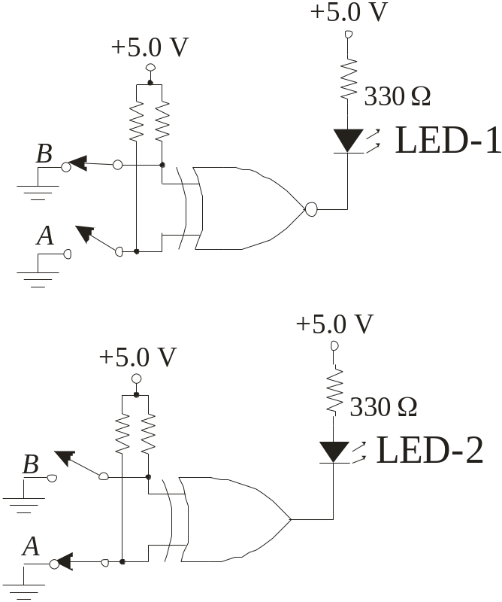
Quiz
3. An LED that should be ON is
a. LED-1
b. LED-2
c. neither
d. both
© 2008 Pearson Education

Slide 21
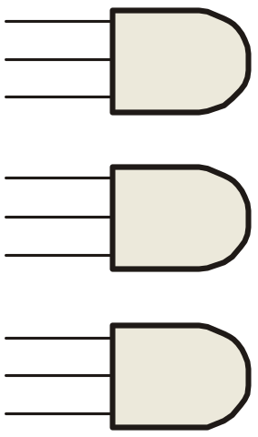
Quiz
4. To implement the SOP expression , the type of gate that is needed is a
a. 3-input AND gate
b. 3-input NAND gate
c. 3-input OR gate
d. 3-input NOR gate
X = ABC + ABD + BDE
A
B
C
A
B
D
B
D
E
© 2008 Pearson Education

Slide 22
Quiz
5. Reading the Karnaugh map, the logic expression is
a. A C + A B
b. A B + A C
c. A B + B C
d. A B + A C
© 2008 Pearson Education

Slide 23
Quiz
6. The circuit shown will have identical logic out if all gates are changed to
a. AND gates
b. OR gates
c. NAND gates
d. NOR gates
A
B
C
D
© 2008 Pearson Education

Slide 24
Quiz
7. The two types of gates which are called universal gates are
a. AND/OR
b. NAND/NOR
c. AND/NAND
d. OR/NOR
© 2008 Pearson Education

Slide 25
Quiz
8. The circuit shown is equivalent to an
a. AND gate
b. XOR gate
c. OR gate
d. none of the above
A
B
© 2008 Pearson Education

Slide 26
Quiz
9. The circuit shown is equivalent to
a. an AND gate
b. an XOR gate
c. an OR gate
d. none of the above
A
B
© 2008 Pearson Education

Slide 27
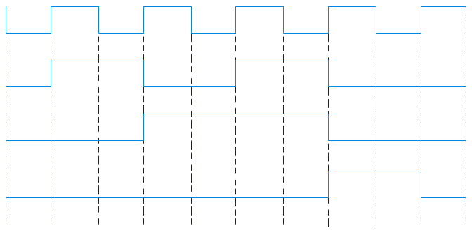
Quiz
10. During the first three intervals for the pulsed circuit shown, the output of
a. G₁ is LOW and G₂ is LOW
b. G₁ is LOW and G₂ is HIGH
c. G₁ is HIGH and G₂ is LOW
d. G₁ is HIGH and G₂ is HIGH
A
A
G₁
B
B
G₃
C
C
D
G₂
D
© 2008 Pearson Education

Slide 28
Quiz
Answers:
1. b
2. d
3. a
4. c
5. d
6. c
7. b
8. c
9. a
10. c

